Slide 1
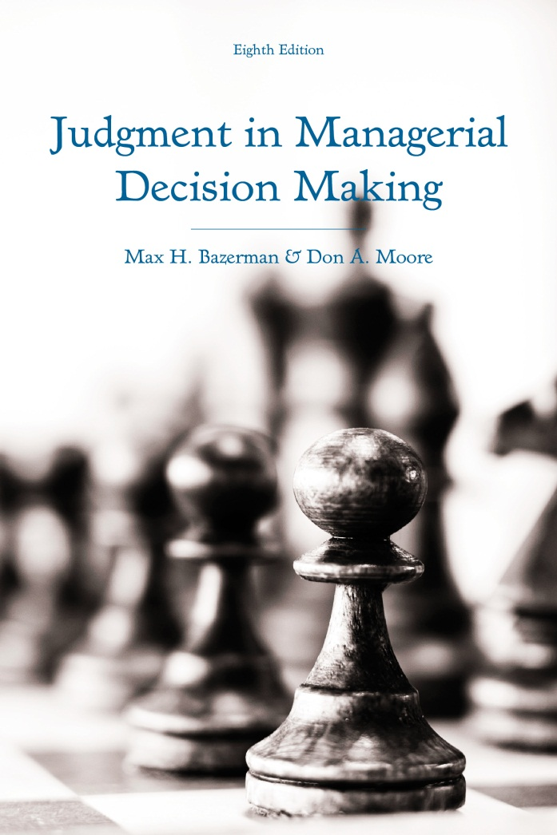
Judgment in Managerial Decision Making 8e
Chapter 11
Negotiator Cognition
Copyright 2013 John Wiley & Sons

Slide 2
Common Mistakes of Negotiators
The fixed pie myth
Framing of negotiator judgment
Escalation of conflict
Overestimating your value
Self-serving biases
Anchoring biases
Notes:
Now that we have a framework for making rational decisions in negotiations, we can start to consider the ways in which negotiators often deviate from the decision-analytic framework.
Cognitive biases are often responsible for deviations from rational decision-making in negotiations. Some of the most common biases of negotiators include:
The myth of there being a fixed pike of resources in a negotiation.
Negotiator judgment being influenced by framing.
Unnecessary conflict being escalated.
Negotiators overestimating their value.
Negotiators being influenced by self-serving biases.
Negotiators anchoring to arbitrary offers and reference points.
We will discuss these biases.

Slide 3
The Mythical Fixed Pie of Negotiation
Assumption that interests directly conflict
Perception of negotiations as win-lose
Devaluation of counterpart concessions
Notes:
- As mentioned previously, in mixed-motive interactions with the potential for mutually beneficial integrative agreements to be struck, negotiators can create value by conceding on issues they care little about in exchange for their counterparts conceding on issues that are valued more highly by a focal negotiator.
- However, many negotiators are unable to create value because they typically view negotiations as a distribution of resources from a “fixed pie”.
This assumption holds that negotiator interest directly conflict with one another.
Thus, people view any concession as a losing course of action. In general, this fosters a view of negotiations as win-lose rather than win-win where both sides can obtain outcomes more favorable than their BATNA.
One manifestation of this tendency to view negotiations as a fixed pie is that counterpart concessions are often devalued because they are perceived as attempts to take resources away rather than attempts to create new resources to be distributed between both parties.
For example, negotiators rate identical offers more favorably when they proposed the offer than when a counterpart proposed the offer to them.

Slide 4
Buying a Condo
You bought your condo in 2005 for $250,000. You have just put it on the market for $299,000, with a real target of $290,000 (your estimation of the condo’s true market value). An offer comes in for $280,000.
Does this offer represent a $30,000 gain in comparison with the original purchase price or a $10,000 loss in comparison with your current target?
Notes:
Consider this scenario for a moment.
How do you frame this situation?
Clearly, this situation can be framed in two different ways.
The way that a negotiator frames it will likely influence his or her strategies in the negotiation.
Representing the offer as a $30,000 gain will make him or her likely to accept the offer of $280,000.
Representing the offer as a $10,000 loss from your target likely leads to a rejection of the offer.

Slide 5
The Framing of Negotiator Judgment
Lead others to positively frame
Challenge negatively framed negotiators
Mediators should promote positive frames
Notes:
As illustrated, framing playa key role in dictating negotiator preferences.
This suggests several key pieces of prescriptive advice:
Negotiators should encourage their counterparts to adopt a positive frame. This will make their counterparts more likely to accept offers.
When faced with a negotiator who is clearly negatively framed, negotiators should call the negotiator’s attention to their negative frame by emphasizing that he or she has adopted a risky strategy that may lead to an impasse in a situation where mutual gain is possible.
From the perspective of mediators, this suggests that they should encourage both negotiators to adopt a positive frame.
Given that what may be a positive frame for one negotiator is likely to be a negative frame from the perspective of another, mediators should meet with negotiators separately and encourage them to adopt different frames that are each positive.
This can also help create a large bargaining zone.

Slide 6
Escalation of Conflict
Examples
  MLB
  NBA
Prior prices influence escalatory tendencies
Announcing one’s position
Preventing the escalation of conflict
  Avoid eliciting firm statements
  Work around rigid positions
Notes:
The irrational escalation of conflict happens frequently. Here are two examples taken from the world of professional sports:
In 1994, Major League Baseball players went on strike during the middle of the season that effectively ended the season.
Owners and players lost hundreds of millions of dollars during the strike.
A reasonable solution could have been to continue playing out the season with money going into a pot that would later be divided once a settlement had been reached about how to divide it.
However, because both sides were so focused on beating the other side, they escalated their commitment to preventing the other side from getting what it wanted. This proved economically disastrous for both parties.
In 2011, the National Basketball Association locked out its players as the result of an inability to arrive at a new collective bargaining agreement.
Both sides eventually came to an agreement.
However, the agreement came after missing 1/5 of the season and both sides losing hundreds of millions of dollars.
Evidence suggests that one reason for the escalation of conflict is that parties are influenced by sunk costs, such as prior prices. High sunk costs often place pressure on negotiators to justify the costs by escalating conflict.
Negotiators also place themselves at risk of escalating when they take a firm position on an issue, as they often have difficulty reneging on a firm commitment and as a result end up holding to unrealistic demands for long periods of time.
Given this information, there are two important pieces of prescriptive advice to preventing the escalation of conflict.
First, negotiators should avoid placing a counterpart in a position where he or she feels the need to take a firm stance on an issue.
Second, if a counterpart does take a firm stance on an issue, negotiators may be better served working around the firm stance than attempting to budge a counterpart from it. In doing this, negotiators can identify creative ways to create value for themselves while still allowing their counterpart to hold firm.

Slide 7
Overestimating Your Value in Negotiation
Overestimation of holding firm
Overestimation of acceptance probability
Appropriate calibration promotes success
Limiting overestimation
  Gain more situational knowledge
  Seek third-party objective assessments
Notes:
In addition to escalating conflict, negotiators also tend to overestimate their value in a negotiation.
They overestimate the likelihood that a strategy of holding firm will prevail.
They overestimate the probability of their offers being accepted by a counterpart.
Evidence suggests that negotiators who are well-calibrated with respect to their value are the most likely to reach agreements and overall, they are more successful than overconfident negotiators.
There are some ways that negotiators can limit the likelihood of overestimating their value:
They are the most likely to overestimate their value when little is known about the situation they are in. By gaining more knowledge specific to their situation, negotiators become more likely to accurately estimate the objective value of their position in a negotiation.
Another solution is to consult with neutral third-parties to give objective value assessments.

Slide 8
Self-Serving Biases in Negotiation
Biased perceptions of fairness
Biased information processing
  Role-biased predictions of judge rulings
  Supporting arguments considered more important
Social dilemmas
  Fishing
  Climate change
Limiting self-serving biases
Notes:
In a similar fashion to overestimating our value in a negotiation, we also tend to have perceptions of fairness that are biased in favor of our self-interest.
This occurs because we process information in a biased fashion.
When asked to predict the rulings of judges, people tend to believe that a judge will rule in favor of their position.
When evaluating how much others will weight particular issues, people believe that independent judges will weight the issues that favor them more than the issues that favor their opponents.
Beyond the dyadic negotiation context, self-serving perceptions of fairness influence social dilemmas.
In the case of fishing, there is a common goods problem.
Fishers all want to catch as many fish as they can right now.
However, if all fishers catch as many fish as they want, then there will be no fish left for tomorrow.
An experimental study demonstrated that the greater the extent to which an individual makes self-serving interpretations of fairness, the more he or she chooses to fish in the short-run.
Climate change is another social dilemma where self-serving biases likely play an important role, as different countries have their own perceptions of how much they contribute to emissions and how much burden is on them for addressing the issue. Not surprisingly, these perceptions are almost always biased such that they believe that they bear less responsibility than other countries seem to believe. Unfortunately, this is one reason that attempts to regulate emissions are significantly delayed.
Negotiators who wish to limit the possibility of engaging in self-serving biases should do the following to better understand the perspective of others and limit the potential for biased information processing:
Ask questions
Seek tradeoffs
Make concessions

Slide 9
Anchoring in Negotiations
Anchoring to arbitrary prices
Anchoring to first offers
  Ambiguity enhances anchoring effect
  Precision enhances anchoring
Focus on your goals
Notes:
The final cognitive bias that commonly influences negotiation outcomes that we will discuss is anchoring.
When anchors are set at arbitrary prices, this can have an influence on negotiation outcomes.
List prices influence brokers’ assessments of property value.
The order in which potential offers are presented influence outcomes. For example, list prices that are listed in descending order of price tend to promote more favorable outcomes for buyers than list prices that are listed in ascending order.
This finding suggests that people tend to anchor to the first potential offers that they see. Not surprisingly, evidence suggests that in general, people tend to anchor to first offers.
However, a first offer must be reasonable and within the bargaining zone of a counterpart.
When a counterpart has a good sense of the bargaining zone and the value that he or she places on the item being negotiated, anchoring has less of an effect than when the item being negotiated is more ambiguous or the bargaining zone is less clear.
Interestingly, people are also more likely to anchor to precise offers than rounded offers. For example, making an initial offer of $199.99 is more likely to create a strong anchor for a counterpart than an initial offer of $200.
Overall, the evidence suggests that negotiators can really take advantage of an ambiguous item by making precise first offers that are within the bargaining zone, but close to the more favorable end of their own bargaining zone.
Negotiators can avoid being influenced by anchors by focusing on their own goals and BATNA. When people reduce ambiguity by making these factors clear, they are less susceptible to the influence of anchors.

